Slide 1
Tutorial 9
BUSINESS
AND
FINANCE
Tan Zi Ying
Ho Lun Fa
Chong Zi Hui
Low Jing Yong
Soh Ruiyang

Slide 2
SCOPE
Summary
Q 13 – 1
P 13 – 2(Operating Cash Flow)
P 13 – 19(New Project Analysis)
P 13 – 13(Unequal Lives)

Slide 3
Summary (Part 1)
Ho Lun Fa
Singaporean
Civil Engineering, Year 2

Slide 4
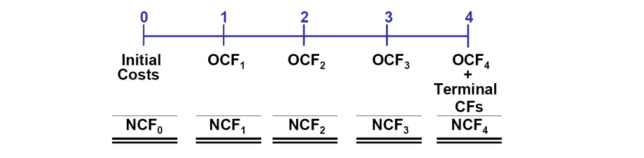
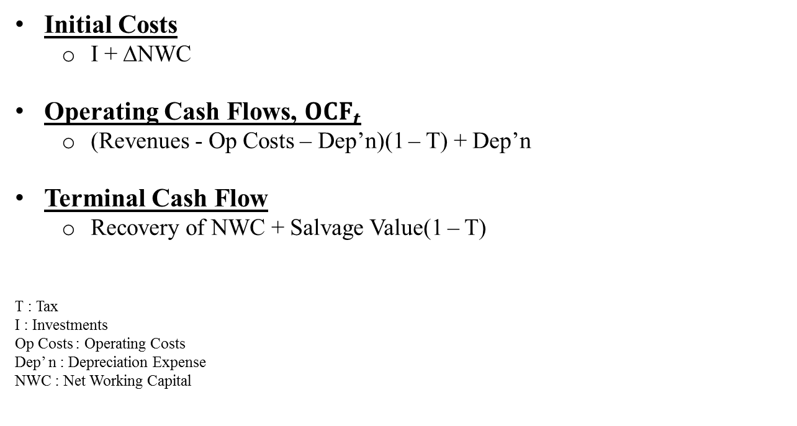
Relevant cash flow
Initial Costs
I + ∆NWC
Operating Cash Flows, ${OCF}_{t}$
(Revenues - Op Costs – Dep’n)(1 – T) + Dep’n
Terminal Cash Flow
Recovery of NWC + Salvage Value(1 – T)
T : Tax
I : Investments
Op Costs : Operating Costs
Dep’ n : Depreciation Expense
NWC : Net Working Capital

Slide 5
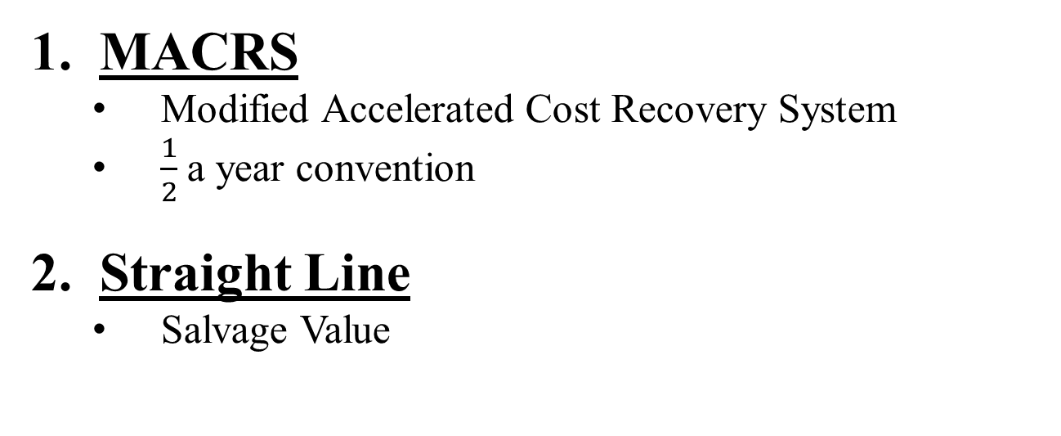
Depreciation expense
MACRS
Modified Accelerated Cost Recovery System
$\frac{1}{2}$a year convention
Straight Line
Salvage Value

Slide 6
Analysis
INCLUDED | EXCLUDED
Opportunity Cost | Financing Effects (Interest Expense and Dividend)
Externalities (Complements or Cannibalization) | Sunk Cost
Inflation
Replacement rather than a New Project

Slide 7
PROJECT RISK
Stand Alone Risk
Project’s Total risk if it was operated alone
Corporate Risk
Project’s Risk when considering the firm’s other projects
Market Risk
Project’s Risk to a well diversified investor

Slide 8
Summary (Part 2)
Soh Ruiyang
Singaporean
Common Engineering, Year 1

Slide 9
Sensitivity analysis
Measures the effect of changes in a variable on the project’s NPV
Advantages:
Identifies the variables with the greatest potential impact on profitability
Allowing the management to focus on these variables
Disadvantages:
Does not take into account the probability of occurrence

Slide 10
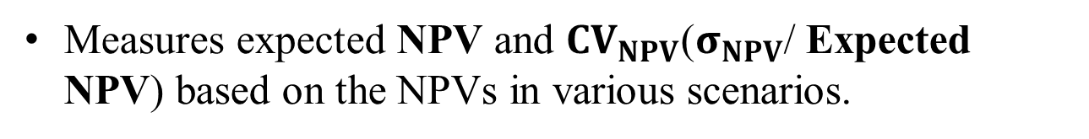
Scenario analysis
Measures expected NPV and ${CV}_{NPV}$($σ_{NPV}$/ Expected NPV) based on the NPVs in various scenarios.

Slide 11
Q13 - 1

Slide 12
Q13 – 1
Operating cash flows rather than accounting profits are listed in Table 13-1. Why do we focus on Cash Flows as opposed to Net Income in Capital Budgeting?
Capital Budgeting --- Lecture 8
Analysis of potential projects such as investments in tangible fixed assets
Long term decisions which involve large expenditures
Cash Flows --- FOCUS
Actual Cash Payment during the given time period
Indicates the amount of cash available for other expenses (e.g, Investments or Purchases or bank interest payments)
Determines whether you can pay for the expense
Net Income
Representation of the Shareholder’s Income
Not income of the Company
It may be earned now but cash only received the next accounting year.
Future Cash Flows cannot pay for present expenses

Slide 13
P13 - 2
Tan Zi Ying
Singaporean
Materials Science and Engineering, Year 2

Slide 14
P13 – 2
Estimate the first-year Net Operating Cash Flow for a proposed project.
Sales revenues: $10 million
Operating Costs (excluding depreciation): $7 million
Depreciation: $2 million
Interest expense: $2 million
40% tax rate
WACC is 10%.

Slide 15
P13 - 2
a) What is the project’s Operating Cash Flow for the first year?
 | Year 1
Sales revenue | $10 million
- Operating Costs | - $7 million
- Depreciation | - $2 million
Operating Income (Before Tax) | $1 million
- Tax (40%) | - $0.4 million
Operating Income (After Tax) | $0.6 million
+ Depreciation | + $2 million
Operating Cash Flow | $2.6 million

Slide 16
P13 - 2
b) If the project would cannibalize other projects by $1million of cash flow before taxes per year, how would this change your answer to part a?
Definition of Cannibalization:
Where a company’s new projects take away cash flows from its existing projects

Slide 17
P13 - 2
 | Year 1
Sales revenue | $10 million
- Operating Costs | - $7 million
- Cannibalized Cost | - $1 million
- Depreciation | - $2 million
Operating Income (Before Tax) | $0 million
- Tax (40%) | - $0 million
Operating Income (After Tax) | $0 million
+ Depreciation | + $2 million
Operating Cash Flow | $2 million
Note: Cannibalized Cost is $1 million but operating cash flow only drops by $0.6 million because it save a tax value of $0.4 million.
Add back Depreciation because it is not cash flow and is still in you pocket.

Slide 18
P13 - 2
c) Ignore part b. If the tax rate dropped to 30%, how would that change your answer to part a?
 | Year 1
Sales revenue | $10 million
- Operating Costs | - $7 million
- Depreciation | - $2 million
Operating Income (Before Tax) | $1 million
- Tax (30%) | - $0.3 million
Operating Income (After Tax) | $0.7 million
+ Depreciation | + $2 million
Operating Cash Flow | $2.7 million

Slide 19
P13 - 19
Low Jing Yong
Singaporean
Economics, Year 3

Slide 20
P13 - 19
Considering a New Machine
Costs: $250 000
Reduce Pre-Tax Manufacturing Costs: $90 000 annually
Use 3 Years MACRS Method to depreciate the machine
A value of $23 000 at the end of its 5 year operating life
Applicable Depreciation Rates: 33, 45, 15, 7 percent
Working Capital increase by $25 000 initially,
Recovered at the end of 5 Years Life
Marginal Tax Rate: 40%
WACC: 10%

Slide 21
P13 - 19
a) Calculate the project’s NPV
In order to calculate the NPV, we first need to calculate the depreciated value of the machine for each year.
Depreciation = Investment (machine) x Depreciation rate
Year | Rate | Basis | Depreciation
1 | 0.33 | 250,000 | 82,500
2 | 0.45 | 250,000 | 112,500
3 | 0.15 | 250,000 | 37,500
4 | 0.07 | 250,000 | 17,500
5 | 0 | 250,000 | 0

Slide 22
 | 0 (Initial year net CF) | 1 | 2 | 3 | 4 | 5 (Terminal year net CF)
Investment (machine) | (250,000)
Net Operating WC | (25,000)
Cost saving |  | 90,000 | 90,000 | 90,000 | 90,000 | 90,000
Depreciation |  | 82,500 | 112,500 | 37,500 | 17,500 | 0
Operating Income (BT ) |  | 7,500 | (22,500) | 52,500 | 72,500 | 90,000
Taxes (40%) |  | 3,000 | (9,000) | 21,000 | 29,000 | 36,000
Operating Income (AT) |  | 4,500 | (13,500) | 31,500 | 43,500 | 54,000
Add Depreciation |  | 82,500 | 112,500 | 37,500 | 17,500 | 0
Operating CF |  | 87,000 | 99,000 | 69,000 | 61,000 | 54,000
Return of NOWC |  |  |  |  |  | 25,000
Gain from Sales of FA |  |  |  |  |  | 23,000
Tax on gains from sale of FA |  |  |  |  |  | (9,200)
Net CF | (275,000) | 87,000 | 99,000 | 69,000 | 61,000 | 92,800

Slide 23
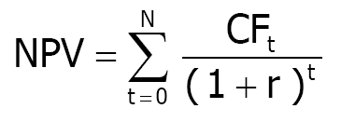
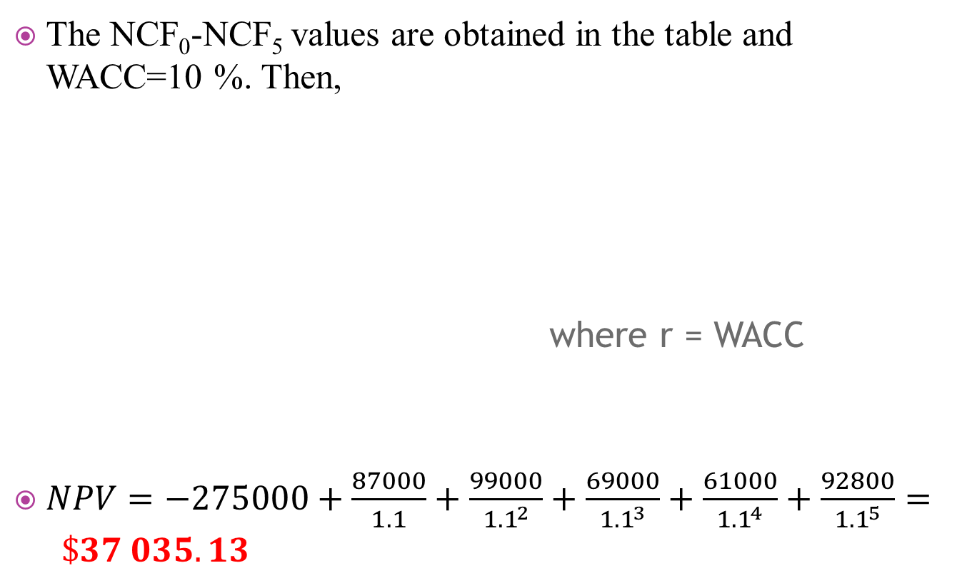
P13 - 19
The NCF₀-NCF₅ values are obtained in the table and WACC=10 %. Then,
where r = WACC
$NPV=−275000+\frac{87000}{1.1}+\frac{99000}{{1.1}^{2}}+\frac{69000}{{1.1}^{3}}+\frac{61000}{{1.1}^{4}}+\frac{92800}{{1.1}^{5}}= \$37 035.13$

Slide 24
P13 - 19
c) Suppose the CFO wants you to do a scenario analysis with different values for the cost savings, the machine’s salvage value, and the working capital (WC) requirement. She asks you to use the following probabilities and values in the scenario analysis:
SCENARIO | PROBABILITY | COST SAVINGS | SALVAGE VALUE | NOWC
Worst case | 0.35 | $72,000 | $18,000 | $30,000
Base case | 0.35 | 90,000 | 23,000 | 25,000
Best case | 0.30 | 108,000 | 28,000 | 20,000
Calculate the project’s expected NPV, its standard deviation, and its coefficient of variation. Would you recommend that the project be accepted?

Slide 25
P13 - 19
In this question however we have been given the best and the worst case values of NPV as follows:
NPV_{WORST} = -$7,663.52
NPV_{BASE} = $37,035.13
NPV_{BEST} = $81,733.79
The expected value of NPV is given as the weighted probability
E(NPV) = NPV_{WORST}(0.35)+ NPV_{BASE}(0.35) + NPV_{BEST}(0.30)
= $34,800.20

Slide 26
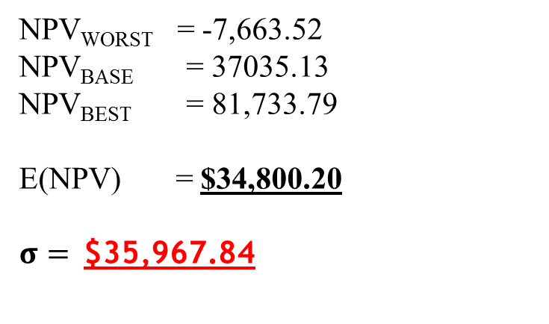
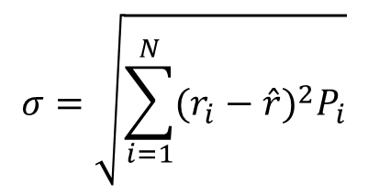
P13 - 19
$$σ=\sqrt{\sum_{i=1}^{N}{(r_{i}−\hat{r})^{2}P_{i}}}$$
NPV_{WORST} = -7,663.52
NPV_{BASE} = 37035.13
NPV_{BEST} = 81,733.79
E(NPV) = $34,800.20
$σ=$$35,967.84
Coefficient of variation which is a measure of dispersion about the expected value is found to be, CV = σ/ E(NPV)
=1.03
Yes.
Because
Expected NPV is positive and probability of a negative NPV is only 0.35.
Coefficient of variation is 1.03 which is quite low as it is closed to 1. Hence the risk taken is quite low.

Slide 27
P13 - 13
Chong Zi Hui
Singaporean
Materials Engineering, Year 1

Slide 28
P13 - 13
Considering 2 mutually exclusive projects
Initial Investment: $10 000
Typical Average Risk Projects
Project A:
Expected life of 2 years with after tax cash inflows of $6000 and $8000 at the end of Year 1 and 2 respectively
Project B
Expected life of 4 years with after tax cash inflows of $4000 at the end of the next 4 years
WACC: 10%

Slide 29
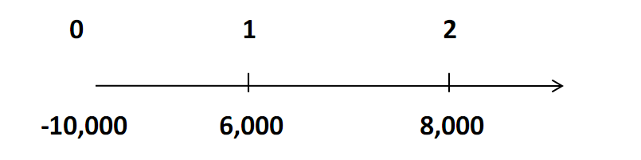
P13 - 13
a) If the projects cannot be repeated, which project should be selected if Haley uses NPV as its criterion for project selection?
Project A
Calculator Method:
Project A: CF₀ = -10,000, CF₁ = 6,000, CF₂ =8,000, I/YR = 10.

Slide 30
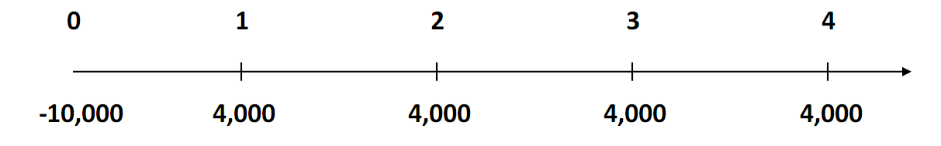
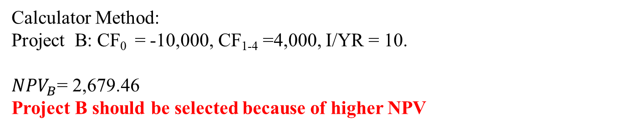
P13 - 13
Project B
Calculator Method:
Project B: CF₀ = -10,000, CF₁₋₄ =4,000, I/YR = 10.
${NPV}_{B}$= 2,679.46
Project B should be selected because of higher NPV

Slide 31
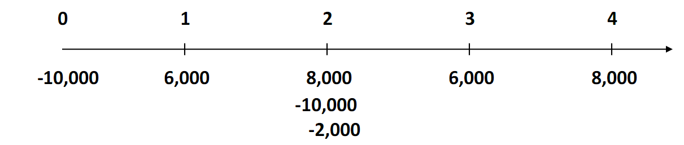
P13 - 13
b) Assume the projects can be repeated and that there are no anticipated changes in the cash flows. Use the replacement chain analysis to determine the NPV of the project selected.
Using replacement chain approach to calculate the extended NPV for Project A in 4-year horizon:

Slide 32
P13 - 13
Calculator Method:
Project A: CF₀ =-10,000, CF₁ = 6,000, CF₂ = -2,000, CF₃ =6,000, CF₄ =8,000, I/YR = 10
(Note: CF₂ = 8,000 – 10,000 = - 2,000)
Comparing 4-year horizon for project A & B,
NPV_{B} = 2,679.46 < NPV_{A} =3,773.65. Project A should be selected.

Slide 33
P13 - 13
c) Make the same assumptions in part b. Use the equivalent annual method to determine the annuity of the project selected.
Project A
N = 2, I/YR = 10, PV = -2,066.12(PV is made Negative!), FV = 0
PMT = EAA = 1,190.48
Project B
N = 4, I/YR = 10, PV = -2,679.46, FV = 0
PMT = 845.29
PMT_{B} = 845.29 < PMT_{A} =1,190.48
Project A should be selected.

Slide 34
THAnk you

